Slide 1
Trash Toss
Sponsored by IDEASS
Impact Designs: Engineering and Sustainability
through Student Service
Claire Watts (Product Owner),
Nick Meddin (Initial Scrum Master),
George Somers,
Vincent Kim,
& Morgan Scofield

Slide 2
Main Idea
Trash Toss is a gaming app that seeks to educate players on proper waste disposal and inspire environmentally responsible action. This project is ongoing, and was initially started by students last year. It is now a part of the IDEASS program [Impact Designs: Engineering and Sustainability through Student Service], and the game will continue to be expanded this quarter through the work of current students.

Slide 3
High Level Goals
Add more difficult items to dispose of based on input from IDEASS program
Add gameplay functionality and detailed graphics to represent such new items
Improve on the existing point system with new incentives
New version testing/Prototype new features
Continuous integration
Build a website to represent game application

Slide 4
Target Audience
People who want to educate themselves on proper waste disposal
Santa Cruz Resource Recovery Facility
plans on using the application for their education program for children to participate in
Geeks and Gamers

Slide 5
User Stories
User Story 1: (On-Going) As a person who works at the Santa Cruz Resource Recovery Facility, I want the game to be factual and incorporate diverse items, in order to reflect real-life complicated recycling situations, so that I can count on the members of Santa Cruz county to recycle properly and make my life easier.
Story Points: 13
User Story 2: As an inexperienced recycler I want a variety of items, so I’ll be prepared to handle more obscure types of waste.
Story Points: 2
User Story 3: As a gamer I want to see descriptive graphics so that the game is clear and visually appealing.
Story Points: 8
User Story 4: As a competitive person I want a detailed score board that reflects my success so that I can brag to my friends.
Story Points: 3
User Story 5: As a kid I want the game to be kid friendly and geared towards child education so I can have fun while learning.
Story Points: 1

Slide 6
User Stories
User Story 6: As an experienced gamer I want a game that has scaling difficulty so I don’t get bored.
Story Points: 5
User Story 7: As a parent I want this game to be fun for all ages so that I am engaged when playing the game with my beautiful and wonderful kids.
Story Points: 1
User Story 8: As a player I want a game with short loading times so the gameplay is as streamlined as possible.
Story Points: 5
User Story 9: As a smartphone user I want this app to be as compact and resource efficient as possible so that it doesn’t have to compete with disc space with other apps.
Story Points: 5
User Story 10: As a user I want the app to have cooler music than it currently does because good music helps me engage in the game.
Story Points: 8

Slide 7
Sprint 1
Creating more nuanced gameplay mechanics, i.e. new items that the user interacts with differently, a sink zone to wash items off, etc.
With the existing and new items, create more diverse cosmetics

Slide 8
Sprint 2
Improve graphics so game is clear and visually appealing
Add a scoreboard that reflects user success so players can brag to their friends
Make the game kid friendly so parents can feel comfortable downloading it for their children

Slide 9
Sprint 3
Implement scaling difficulty so the game doesn’t get too boring
Have the game be fun for all ages so parents playing with their kids don’t get bored
Short loading times to streamline the experience

Slide 10
Sprint 4
Make the app compact so it’s not competing for valuable smartphone hard disk space
Better music/sound FX to keep users engaged

Slide 11
Main Concerns
Misjudging the amount of time/effort a task will take
Not being able to understand the code that already exists
The client changing their mind about what items are desired
Committing to too many tasks
Nuclear fallout

Slide 12
What’s Good
Saving the planet one recycling container at a time
Teamwork making the dream work
Doggos
Fluffers
Zoomers
Puppers
Enlightening the youth
Inspiring a sustainable future
Games
Compost
Magnets

Slide 13
T.HANKS!

Slide 14
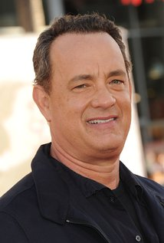
T.HANKS!

Slide 15

T.HANKS!

Slide 16
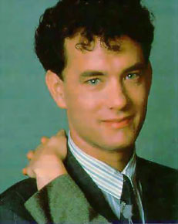
T.HANKS!

